Slide 1
Issues with Scientific Reproducibility
BDK19-1 | Replication, Validation and the spectrum of Reproducibility
Nicole Vasilevsky & Jackie Wirz

Slide 2

http://blogs.msdn.com/b/msr_er/archive/2014/04/29/reproducible-research-are-we-there-yet.aspx

Slide 3
Learning objectives
1
Describe causes that can make science irreproducible
Identify some of the major issues with scientific reproducibility
Describe some ways that you can make your science more reproducible and transparent
2
3

Slide 4
http://www.economist.com/news/briefing/21588057-scientists-think-science-self-correcting-alarming-degree-it-not-trouble

Slide 5
What does it mean to be reproducible?
The ability to recreate or reproduce a scientific experiment, either by the same researcher or an independent researcher, and achieve the same results.

Slide 6
What are causes of irreproducibility?

Slide 7
(Some) Causes of irreproducibility
Incomplete protocol reporting
Reagent variability
Lack of reagent validation
Experimental bias
Differences in analytic techniques
Differences in statistical methods
Unintentional selective reporting
Lack of proper experimental controls
Variations in interpretation
Lack of equipment calibration
Scientific misconduct
http://www.gbsi.org/gbsi-content/uploads/2015/10/The-Case-for-Standards.pdf

Slide 8
What are some examples irreproducibility in science?

Slide 9
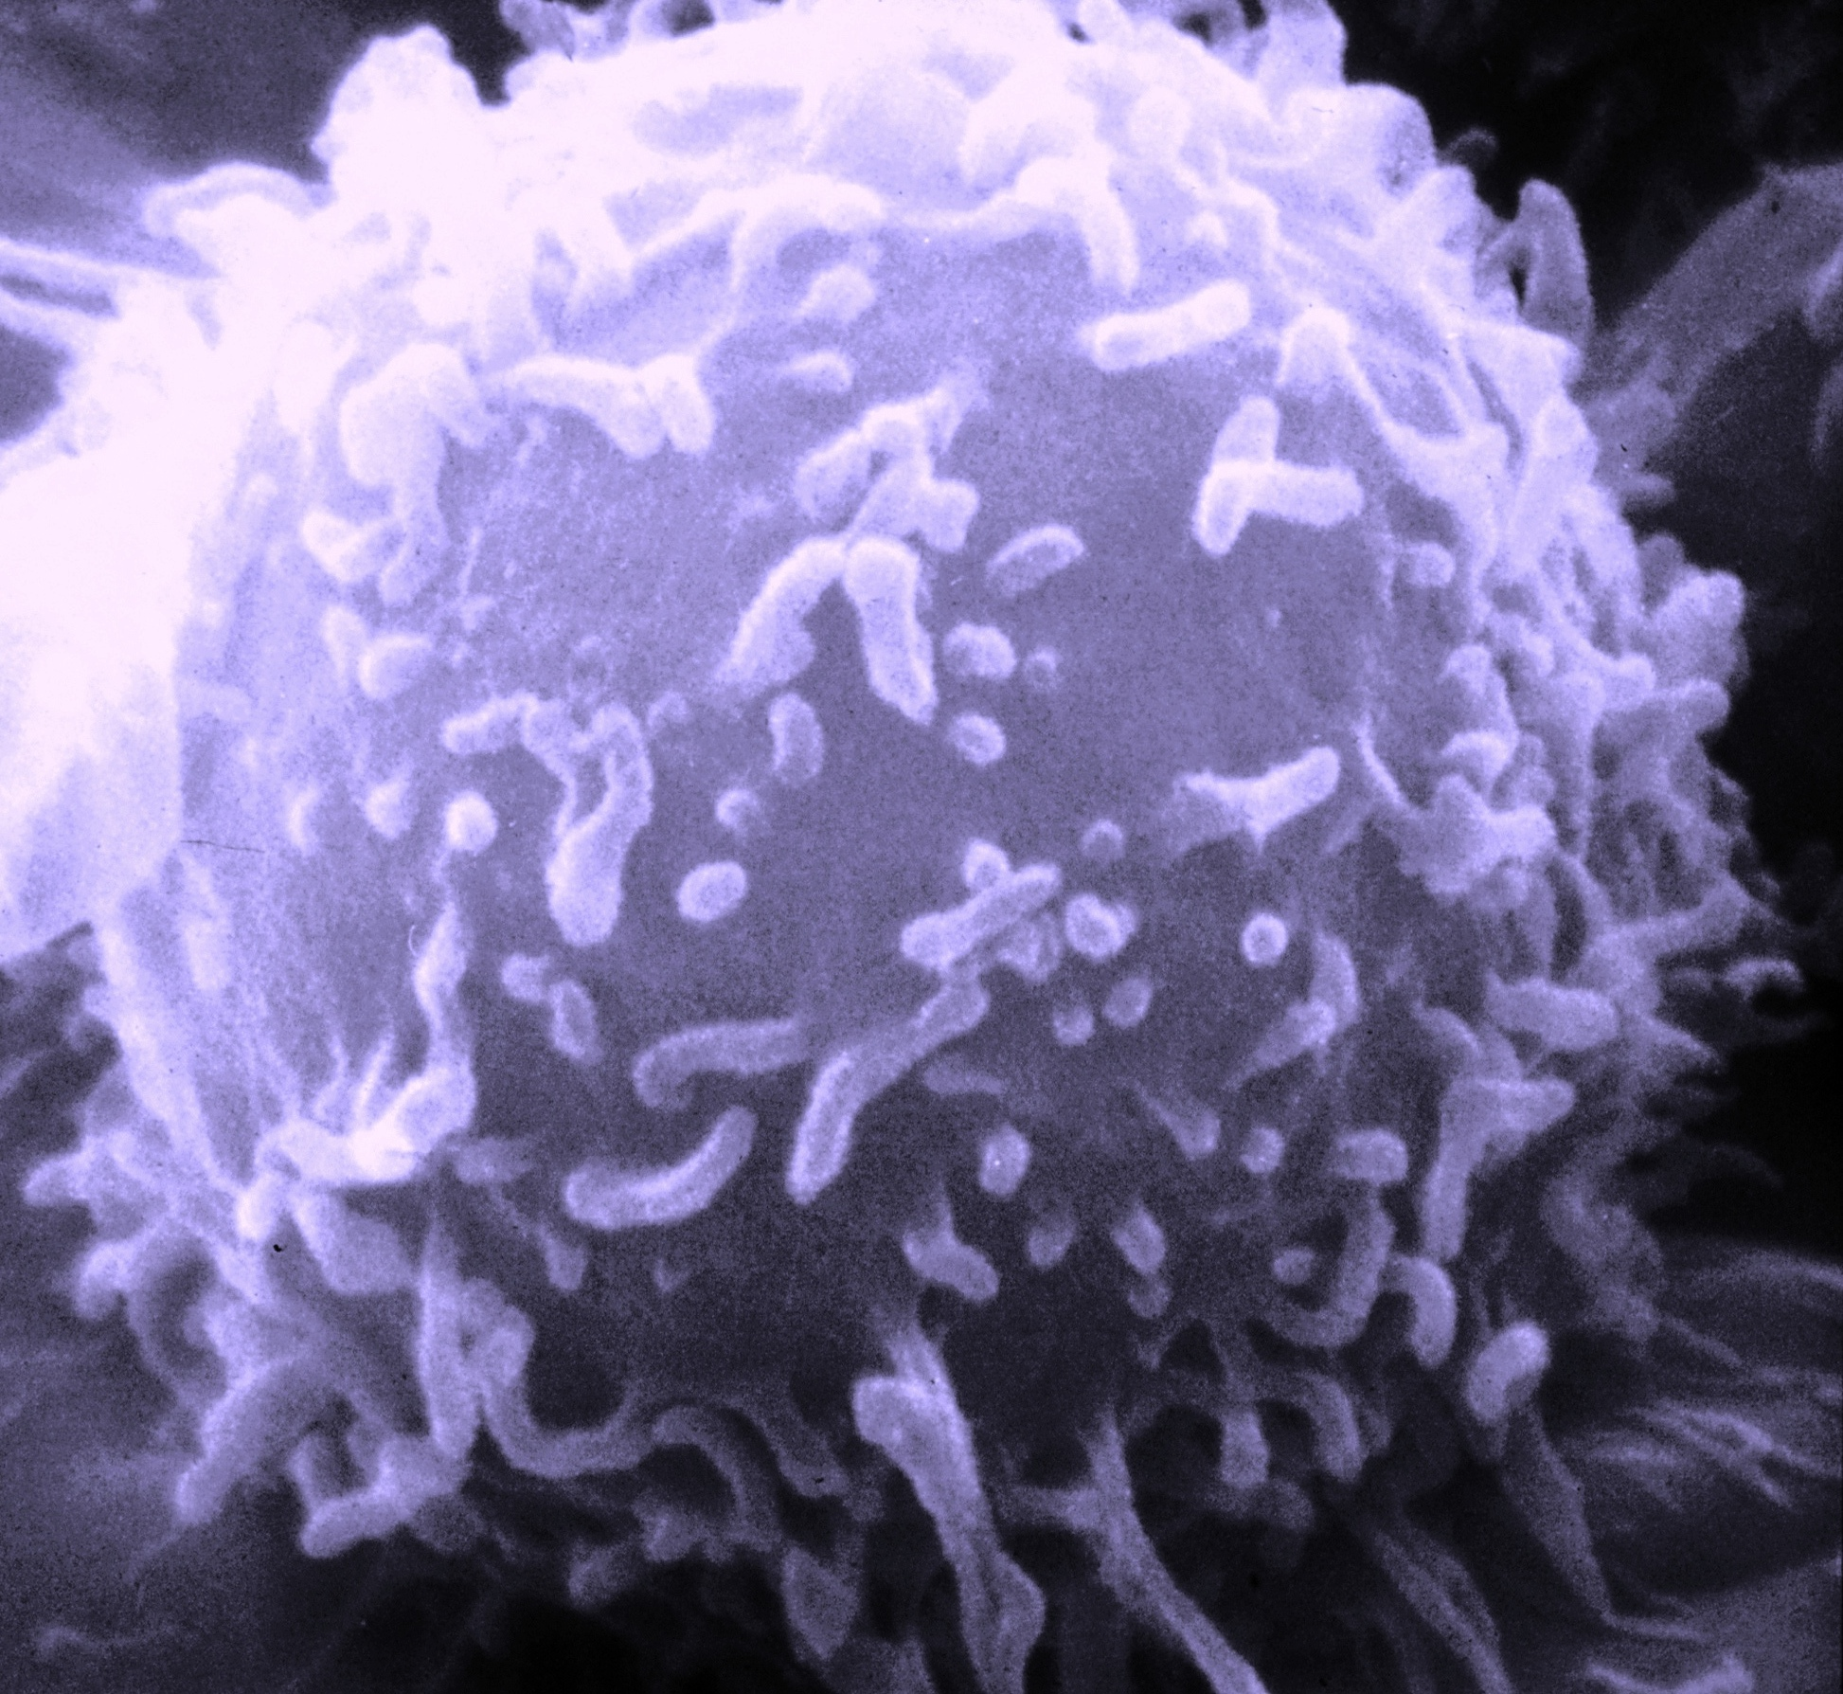
Amgen study
https://en.wikipedia.org/wiki/Cancer_cell
6 out of 53 studies could not be replicated

Slide 10
Issues with reporting animal studies
Study by Hess (2011) identified issues with reporting of animal studies:
Reviewed 100 articles published in Cancer Research in 2010
28% reported that animals were randomly assigned to treatment groups
2% reported that observers were blinded to the treatment groups
0 reported the methods used to determine the number of animals per group
Hess KR. Statistical design considerations in animal studies published recently in Cancer Research. Cancer Res. 2011;71:625

Slide 11
Issues with unique identification of research resources - half of resources are not identifiable
Summary of identifiable resources:
All Resource types
Antibody
Cell line
Resource type | Percent identifiable
Antibody | 44%
Cell line | 43%
Construct | 25%
Knockdown reagent | 83%
Organism | 75%
Fraction identified
Fraction identified
Fraction identified
Cell Bio
Other
Cell Bio
Other
Cell line
Dev Bio
Dev Bio
Antibody
Knockdown
reagent
Construct
Organism
General Bio
General Bio
Immunology
Immunology
Neuroscience
Neuroscience
Knockdown reagent
Construct
Organism
Fraction identified
Fraction identified
Fraction identified
Cell Bio
Other
Cell Bio
Other
Cell Bio
Other
Dev Bio
Dev Bio
Dev Bio
General Bio
General Bio
General Bio
Immunology
Immunology
Immunology
Neuroscience
Neuroscience
Neuroscience
https://peerj.com/articles/148/

Slide 12
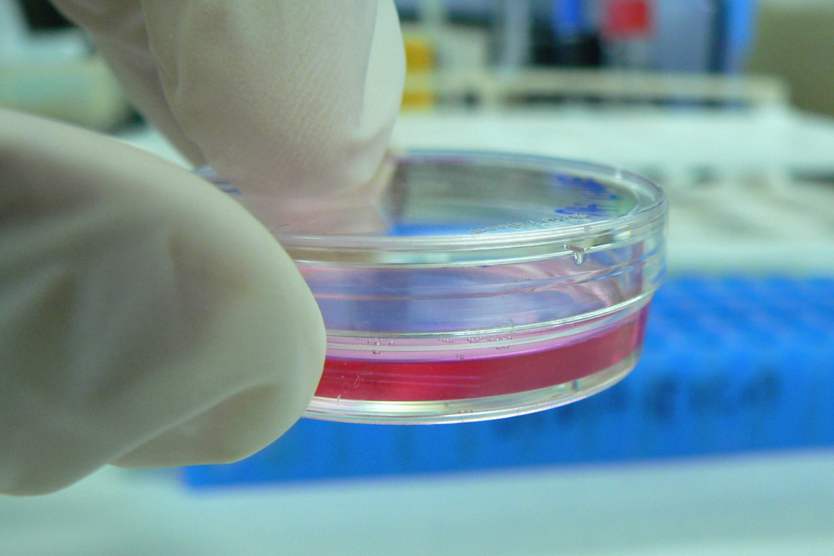
Problems with cell lines
https://en.wikipedia.org/wiki/Cell_culture

Slide 13
Improved reporting and data standards can assist with scientific reproducibility

Slide 14
What are ways we can address issues with scientific reproducibility?

Slide 15
http://www.gbsi.org/gbsi-content/uploads/2015/10/The-Case-for-Standards.pdf

Slide 17
NIH Rigor and Reproducibility
https://www.nih.gov/research-training/rigor-reproducibility

Slide 18
NIH Rigor and Reproducibility
https://www.nih.gov/research-training/rigor-reproducibility/training

Slide 19
Ways to improve reproducibility
Detailed protocol reporting and documentation
Track reagents
Validate reagents
Avoid experimental bias
Analytical techniques
Statistical methods
Improve experimental controls
Anticipate variations in interpretation
Calibrate equipment
Follow ethical guidelines
http://www.gbsi.org/gbsi-content/uploads/2015/10/The-Case-for-Standards.pdf

Slide 20
Review
1
Describe causes that can make science irreproducible
Identify some of the major issues with scientific reproducibility
Describe some ways that you can make your science more reproducible and transparent
2
3

